Slide 1
Harmonic and Anharmonic Frequencies
Mitchell Lahm
Summer Program
July 23, 2026

Slide 2
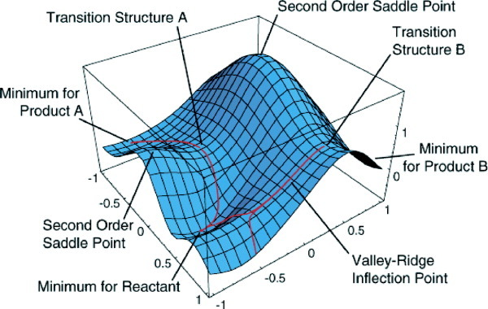
Potential Energy Surfaces
We have learned about a physical construct called a “Potential Energy Surface” that results from the Born-Oppenheimer Approximation.

Slide 3
Potential Energy Surfaces
We have learned about a physical construct called a “Potential Energy Surface” that results from the Born-Oppenheimer Approximation.
Of particular note are the minima and transition states (first-order saddle points).

Slide 4
Potential Energy Surfaces
We have learned about a physical construct called a “Potential Energy Surface” that results from the Born-Oppenheimer Approximation.
Of particular note are the minima and transition states (first-order saddle points).
For a real molecular system, the orientation of the atoms will settle in the minimum energy points.

Slide 5
Potential Energy Surfaces
For a real molecular system, the orientation of the atoms will settle in the minimum energy points.

Slide 6
Potential Energy Surfaces
For a real molecular system, the orientation of the atoms will settle in the minimum energy points.
If a system holds enough energy, it can move between energetic minimum.

Slide 7
Potential Energy Surfaces
For a real molecular system, the orientation of the atoms will settle in the minimum energy points.
If a system holds enough energy, it can move between energetic minimum.
As noted in Jace’s lecture, we can use Transition State Theory to determine the kinetics of a system moving between minima.

Slide 8
Potential Energy Surfaces
As noted in Jace’s lecture, we can use Transition State Theory to determine the kinetics of a system moving between minima.
Minimum energy pathway between minima

Slide 9
Potential Energy Surfaces
As noted in Jace’s lecture, we can use Transition State Theory to determine the kinetics of a system moving between minima.
Minimum energy pathway between minima
In order to locate where these minima and transition states, we perform geometry optimizations, which will be discussed in Kat’s lecture.

Slide 10

We have optimized a geometry. Now what?
Optimizing a molecular geometry identifies a stationary point on the potential energy surface, where $\frac{∂E}{∂X}=0$.

Slide 11
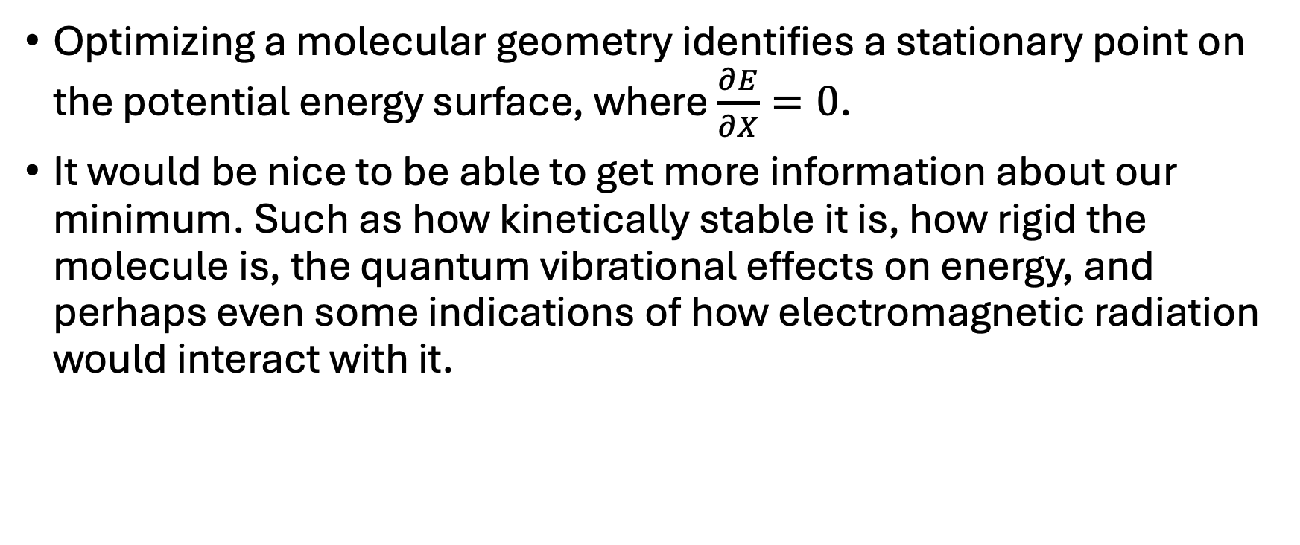
We have optimized a geometry. Now what?
Optimizing a molecular geometry identifies a stationary point on the potential energy surface, where $\frac{∂E}{∂X}=0$.
It would be nice to be able to get more information about our minimum. Such as how kinetically stable it is, how rigid the molecule is, the quantum vibrational effects on energy, and perhaps even some indications of how electromagnetic radiation would interact with it.

Slide 12
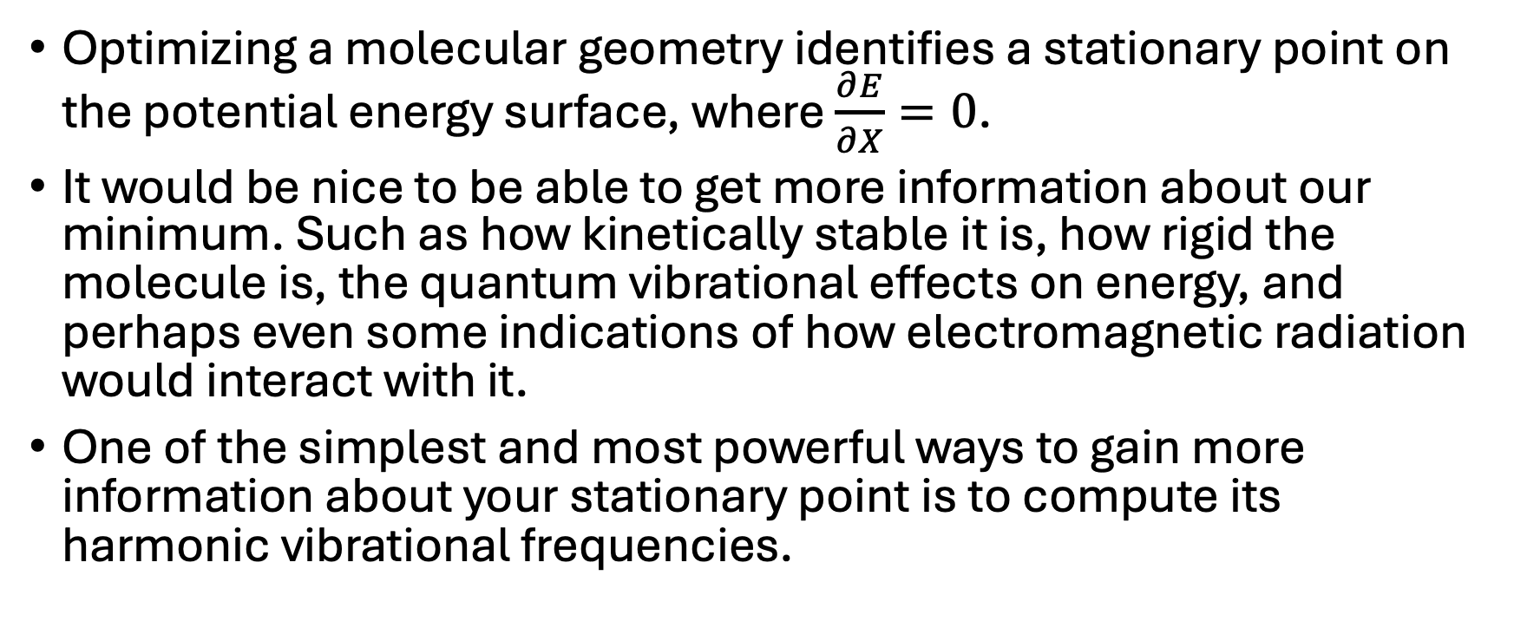
We have optimized a geometry. Now what?
Optimizing a molecular geometry identifies a stationary point on the potential energy surface, where $\frac{∂E}{∂X}=0$.
It would be nice to be able to get more information about our minimum. Such as how kinetically stable it is, how rigid the molecule is, the quantum vibrational effects on energy, and perhaps even some indications of how electromagnetic radiation would interact with it.
One of the simplest and most powerful ways to gain more information about your stationary point is to compute its harmonic vibrational frequencies.

Slide 13

Taylor Series expansion applied to a PES
pic unrelated
A Taylor Series is a mathematical tool that allows you to express any function as a sum of polynomials multiplied by coefficients defined by increasing levels of derivatives at a particular point of the function.

Slide 14
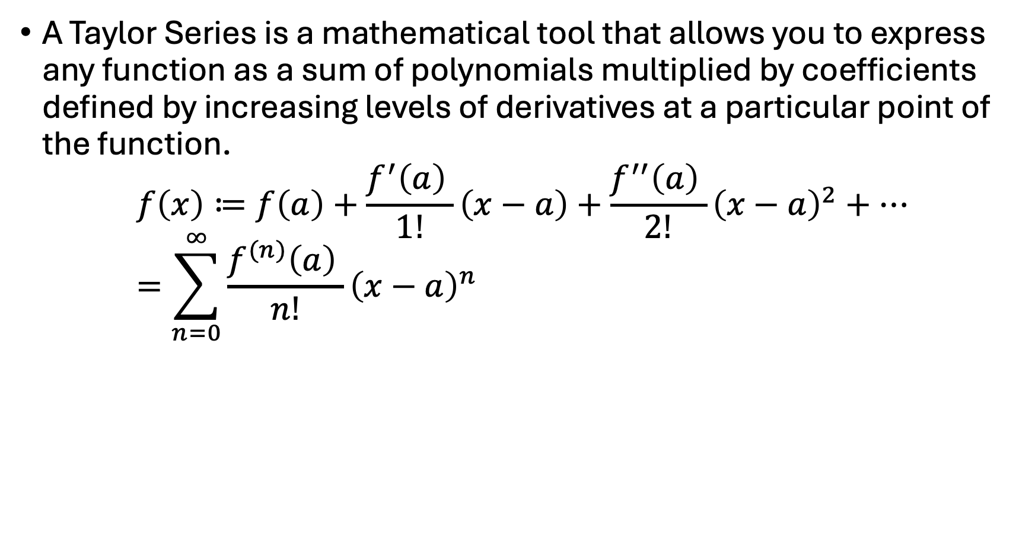
Taylor Series expansion applied to a PES
pic unrelated
A Taylor Series is a mathematical tool that allows you to express any function as a sum of polynomials multiplied by coefficients defined by increasing levels of derivatives at a particular point of the function.
$$f\left(x\right)≔f\left(a\right)+\frac{f^{′}\left(a\right) }{1!}\left(x−a\right)+\frac{f^{′′}\left(a\right) }{2!}{\left(x−a\right)}^{2}+… \\ =\sum_{n=0}^{∞}{\frac{f^{(n)}\left(a\right) }{n!}{\left(x−a\right)}^{n}}$$

Slide 15
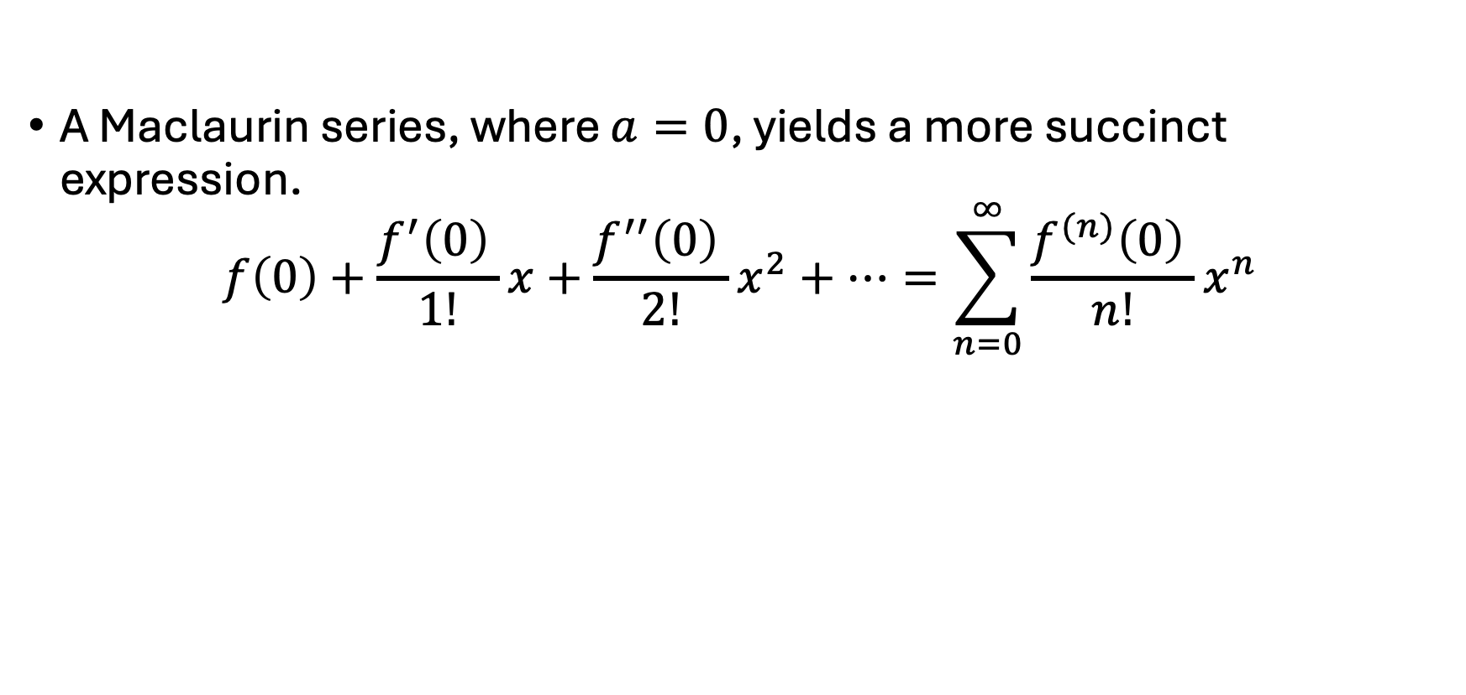
Taylor Series expansion applied to a PES
pic unrelated
A Maclaurin series, where $a=0$, yields a more succinct expression.
$$f\left(0\right)+\frac{f^{′}\left(0\right) }{1!}x+\frac{f^{′′}\left(0\right) }{2!}x^{2}+…=\sum_{n=0}^{∞}{\frac{f^{(n)}\left(0\right) }{n!}x^{n}}$$

Slide 16
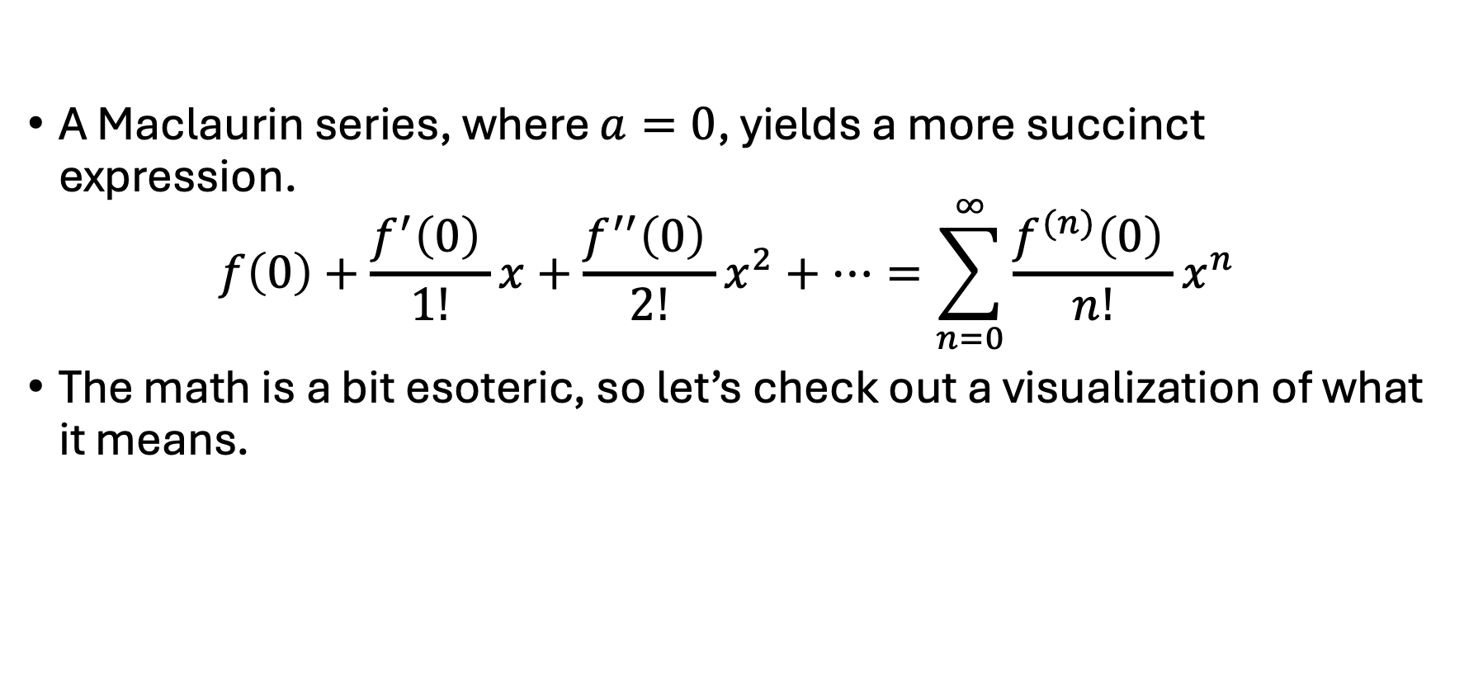
Taylor Series expansion applied to a PES
pic unrelated
A Maclaurin series, where $a=0$, yields a more succinct expression.
$$f\left(0\right)+\frac{f^{′}\left(0\right) }{1!}x+\frac{f^{′′}\left(0\right) }{2!}x^{2}+…=\sum_{n=0}^{∞}{\frac{f^{(n)}\left(0\right) }{n!}x^{n}}$$
The math is a bit esoteric, so let’s check out a visualization of what it means.

Slide 17
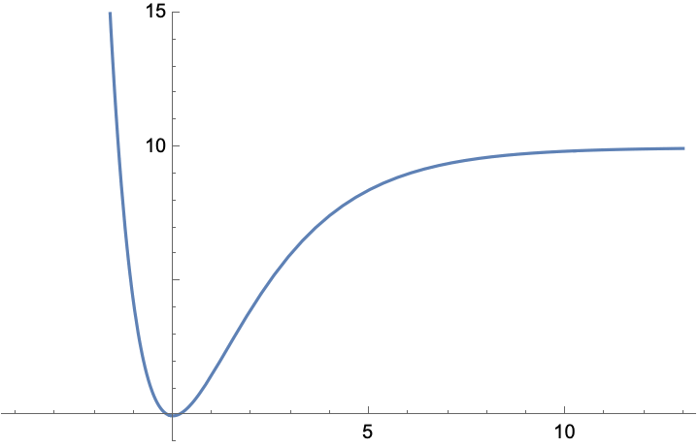

Taylor Series on a Morse Oscillator
pic unrelated
A diatomic molecular potential can be well approximated by a Morse potential.
$$V\left(x\right)=D_{e}{[1−e^{−αx}]}^{2}$$

Slide 18

Taylor Series on a Morse Oscillator
pic unrelated
A diatomic molecular potential can be well approximated by a Morse potential.
$$V\left(x\right)=D_{e}{[1−e^{−αx}]}^{2}$$
What happens if we expand our Taylor Series about 0?

Slide 19
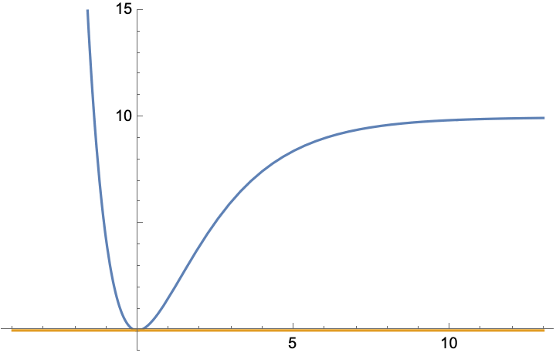

Taylor Series on a Morse Oscillator
pic unrelated
$f\left(x\right)= f\left(0\right)$

Slide 20
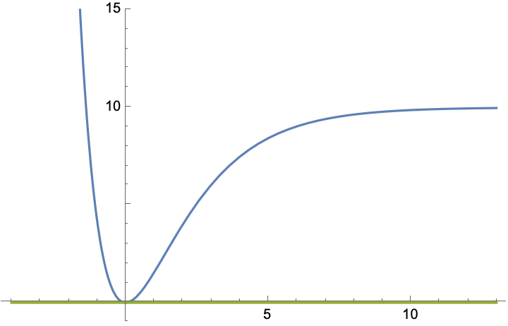

Taylor Series on a Morse Oscillator
pic unrelated
$f\left(x\right)=f\left(0\right)+\frac{f^{′}\left(0\right) }{1!}x$

Slide 21
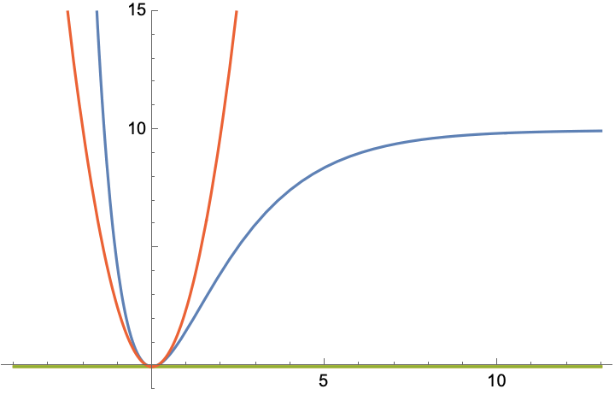

Taylor Series on a Morse Oscillator
pic unrelated
$f\left(x\right)=f\left(0\right)+\frac{f^{′}\left(0\right) }{1!}x+\frac{f^{′′}\left(0\right) }{2!}x^{2}$

Slide 22
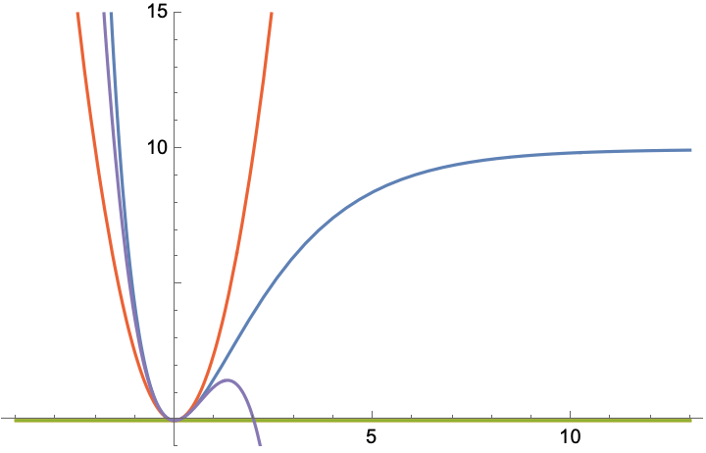

Taylor Series on a Morse Oscillator
pic unrelated
$f\left(x\right)=f\left(0\right)+\frac{f^{′}\left(0\right) }{1!}x+\frac{f^{′′}\left(0\right) }{2!}x^{2}+\frac{f^{′′′}\left(0\right) }{3!}x^{3}$

Slide 23
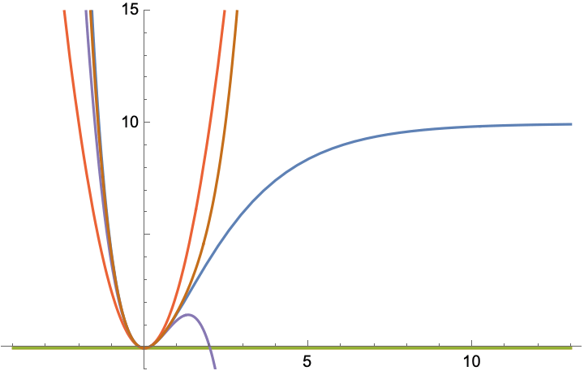

Taylor Series on a Morse Oscillator
pic unrelated
$f\left(x\right)=f\left(0\right)+\frac{f^{′}\left(0\right) }{1!}x+\frac{f^{′′}\left(0\right) }{2!}x^{2}+\frac{f^{′′′}\left(0\right) }{3!}x^{3}+\frac{f^{′′′′}\left(0\right) }{4!}x^{4}$

Slide 24
Taylor Series on a Morse Oscillator
As we can see, our zeroth- and first-order terms don’t tell us much beyond verifying that we are at a stationary point.

Slide 25
Taylor Series on a Morse Oscillator
As we can see, our zeroth- and first-order terms don’t tell us much beyond verifying that we are at a stationary point.
Additionally, while the third- and fourth-order terms do improve on the second-order description, the second-order term has the most drastic improvement from prior terms.

Slide 26
Taylor Series on a Morse Oscillator
As we can see, our zeroth- and first-order terms don’t tell us much beyond verifying that we are at a stationary point.
Additionally, while the third- and fourth-order terms do improve on the second-order description, the second-order term has the most drastic improvement from prior terms.
The second-order description is a component of what Physicists call the Harmonic approximation.

Slide 27

Harmonic Oscillator
A harmonic oscillator in classical mechanics is a particle acted upon by a restoring force proportional to its displacement from equilibrium.
$$F=−kx$$

Slide 28
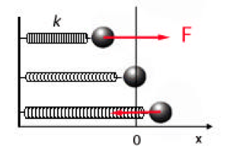
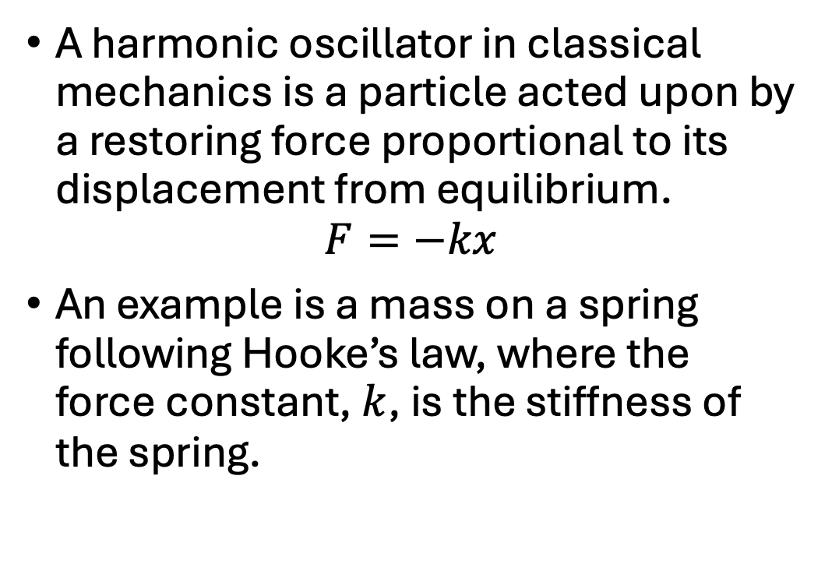
Harmonic Oscillator
A harmonic oscillator in classical mechanics is a particle acted upon by a restoring force proportional to its displacement from equilibrium.
$$F=−kx$$
An example is a mass on a spring following Hooke’s law, where the force constant, $k$, is the stiffness of the spring.
Credit to LibreTexts Chemistry for all figures used here.

Slide 29

Harmonic Oscillator
If we apply Newton’s second law, we get,
$$F=m\frac{d^{2}x}{dt^{2}}=−kx$$
Credit to LibreTexts Chemistry for all figures used here.

Slide 30
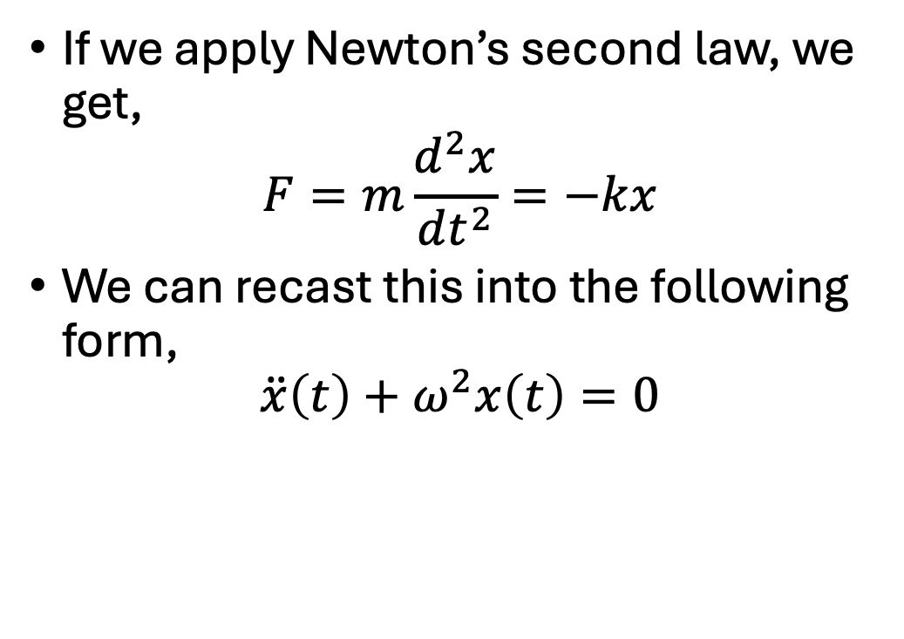
Harmonic Oscillator
If we apply Newton’s second law, we get,
$$F=m\frac{d^{2}x}{dt^{2}}=−kx$$
We can recast this into the following form,
$$\ddot{x}\left(t\right)+ω^{2}x\left(t\right)=0$$
Credit to LibreTexts Chemistry for all figures used here.

Slide 31
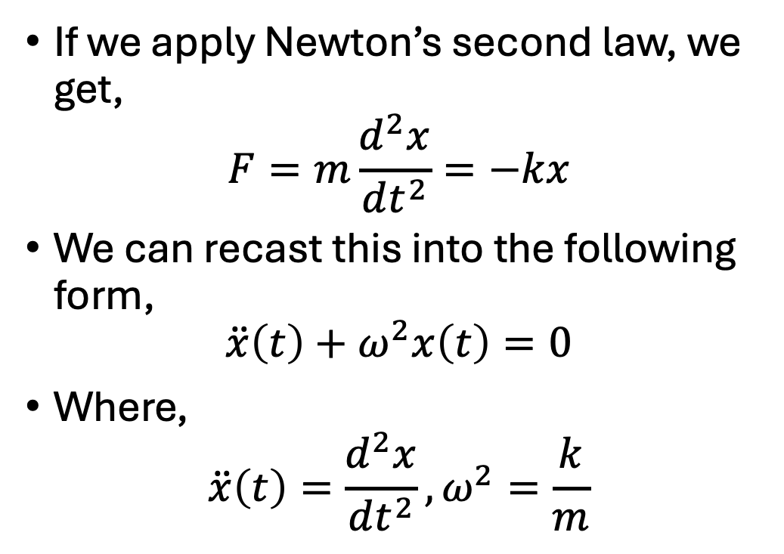
Harmonic Oscillator
If we apply Newton’s second law, we get,
$$F=m\frac{d^{2}x}{dt^{2}}=−kx$$
We can recast this into the following form,
$$\ddot{x}\left(t\right)+ω^{2}x\left(t\right)=0$$
Where,
$$\ddot{x}\left(t\right)=\frac{d^{2}x}{dt^{2}},ω^{2}=\frac{k}{m}$$
Credit to LibreTexts Chemistry for all figures used here.

Slide 32
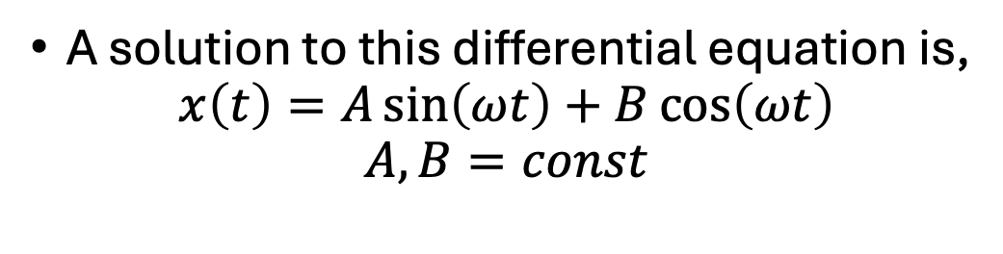
Harmonic Oscillator
A solution to this differential equation is,
$$x\left(t\right)=A\sin\left(ωt\right)+B\cos\left(ωt\right)$$
$$A, B=const$$
Credit to LibreTexts Chemistry for all figures used here.

Slide 33
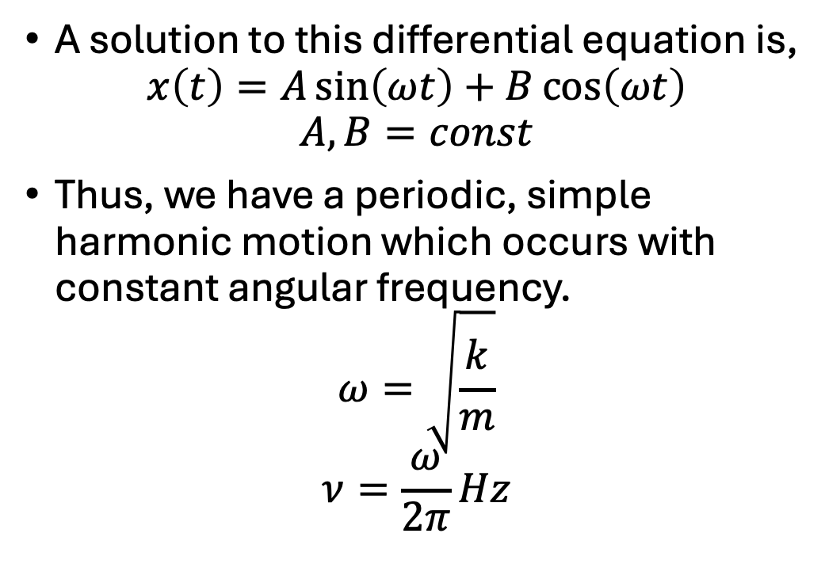
Harmonic Oscillator
A solution to this differential equation is,
$$x\left(t\right)=A\sin\left(ωt\right)+B\cos\left(ωt\right)$$
$$A, B=const$$
Thus, we have a periodic, simple harmonic motion which occurs with constant angular frequency.
$$ω=\sqrt{\frac{k}{m}}$$
$$ν=\frac{ω}{2π}Hz$$
Credit to LibreTexts Chemistry for all figures used here.

Slide 34

Harmonic Oscillator
The potential energy of a harmonic oscillator is,
$$V\left(x\right)=\frac{1}{2}kx^{2}$$
Credit to LibreTexts Chemistry for all figures used here.

Slide 35
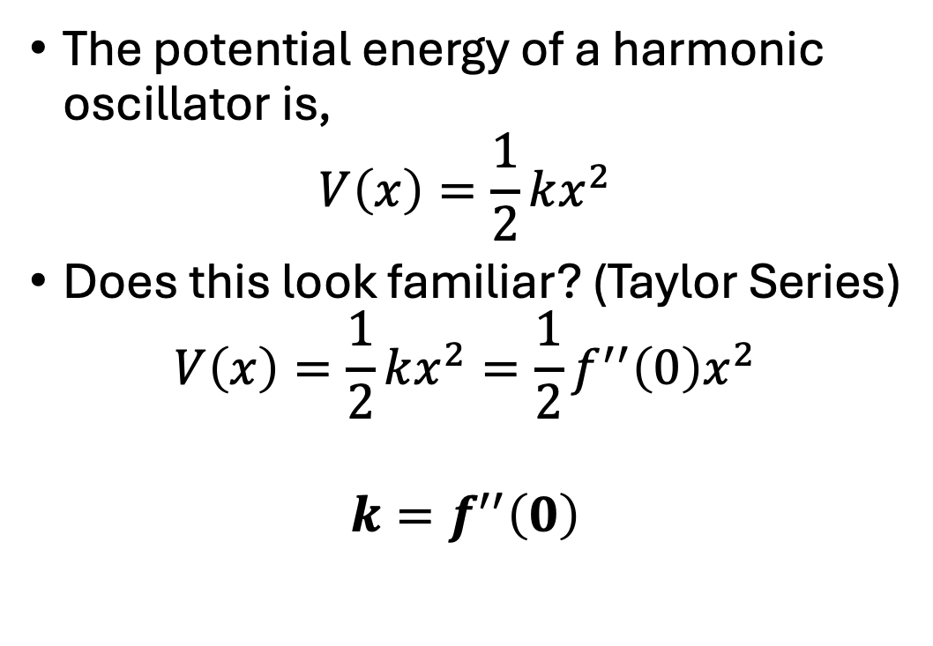
Harmonic Oscillator
The potential energy of a harmonic oscillator is,
$$V\left(x\right)=\frac{1}{2}kx^{2}$$
Does this look familiar? (Taylor Series)
$$V\left(x\right)=\frac{1}{2}kx^{2}=\frac{1}{2}f^{′′}\left(0\right)x^{2}$$
$${k=f}^{′′}\left(0\right)$$
Credit to LibreTexts Chemistry for all figures used here.

Slide 36
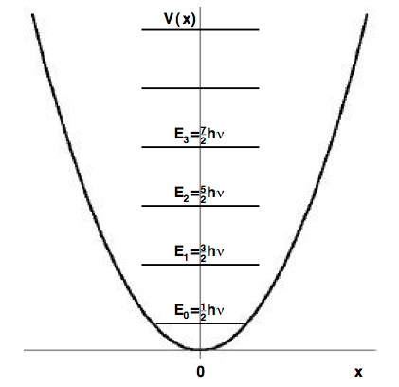
Quantum Harmonic Oscillator
This was all for a classical harmonic oscillator, however our molecules are quantum mechanical.
Credit to LibreTexts Chemistry for all figures used here.

Slide 37
Quantum Harmonic Oscillator
This was all for a classical harmonic oscillator, however our molecules are quantum mechanical.
Thus, our diatomic will oscillate in quantized energy levels
Credit to LibreTexts Chemistry for all figures used here.

Slide 38
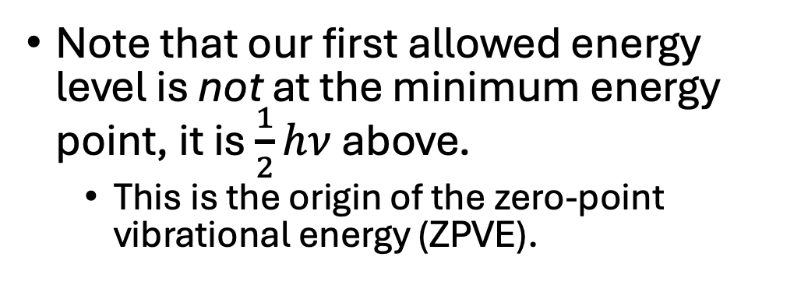
Quantum Harmonic Oscillator
Note that our first allowed energy level is not at the minimum energy point, it is $\frac{1}{2}hν$ above.
This is the origin of the zero-point vibrational energy (ZPVE).
Credit to LibreTexts Chemistry for all figures used here.

Slide 39
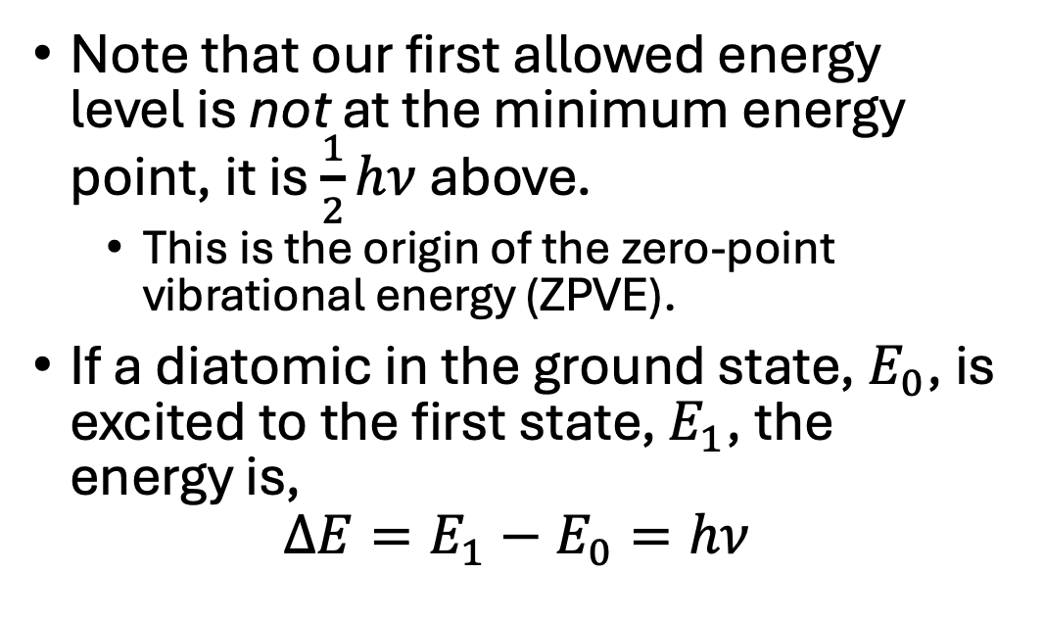
Quantum Harmonic Oscillator
Note that our first allowed energy level is not at the minimum energy point, it is $\frac{1}{2}hν$ above.
This is the origin of the zero-point vibrational energy (ZPVE).
If a diatomic in the ground state, $E_{0}$, is excited to the first state, $E_{1}$, the energy is,
$$ΔE=E_{1}−E_{0}=hν$$
Credit to LibreTexts Chemistry for all figures used here.

Slide 40
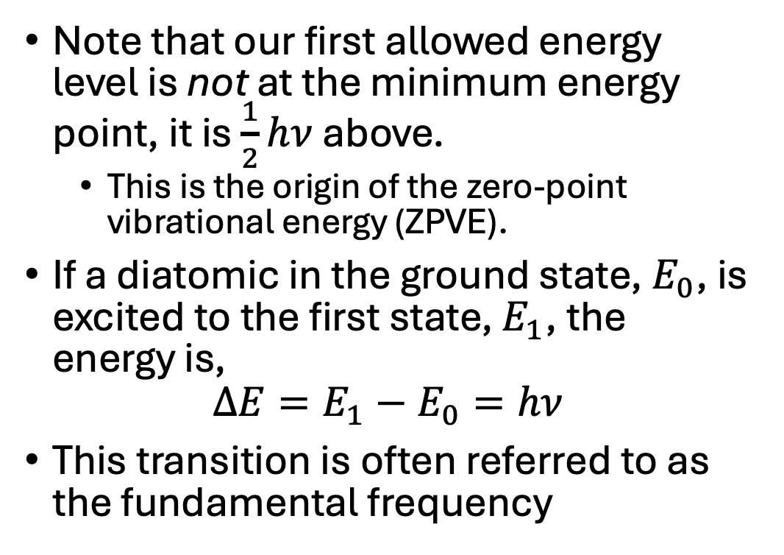
Quantum Harmonic Oscillator
Note that our first allowed energy level is not at the minimum energy point, it is $\frac{1}{2}hν$ above.
This is the origin of the zero-point vibrational energy (ZPVE).
If a diatomic in the ground state, $E_{0}$, is excited to the first state, $E_{1}$, the energy is,
$$ΔE=E_{1}−E_{0}=hν$$
This transition is often referred to as the fundamental frequency
Credit to LibreTexts Chemistry for all figures used here.

Slide 41
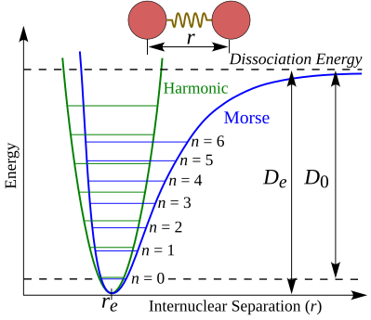
Quantum Harmonic Oscillator
How does this quantum harmonic oscillator compare to a morse oscillator?
Credit to OpenOChem for this figure.

Slide 42
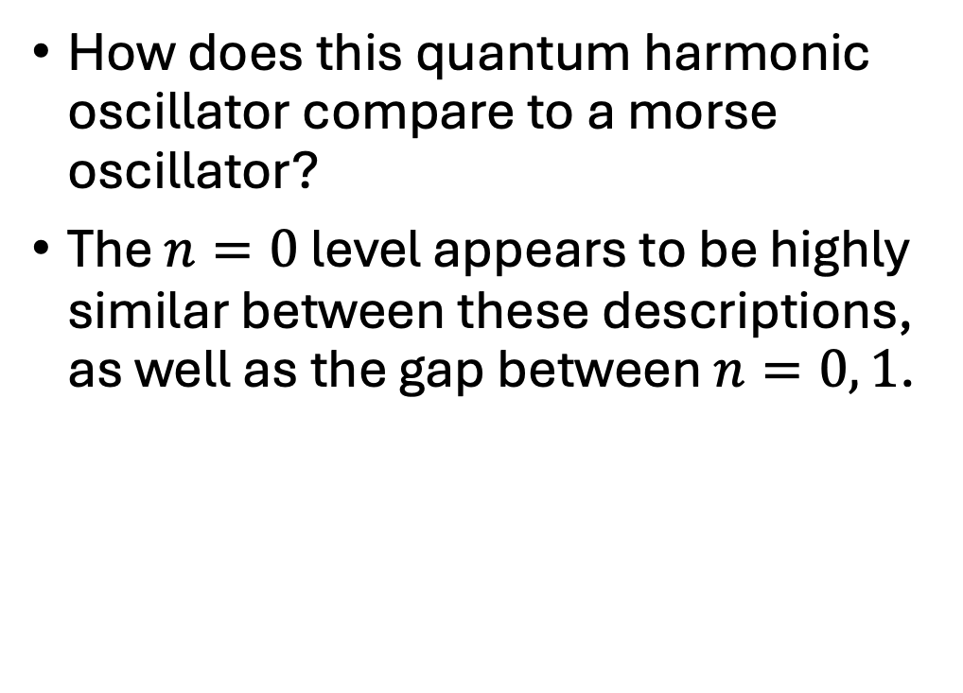
Quantum Harmonic Oscillator
How does this quantum harmonic oscillator compare to a morse oscillator?
The $n=0$ level appears to be highly similar between these descriptions, as well as the gap between $n=0, 1$.
Credit to OpenOChem for this figure.

Slide 43
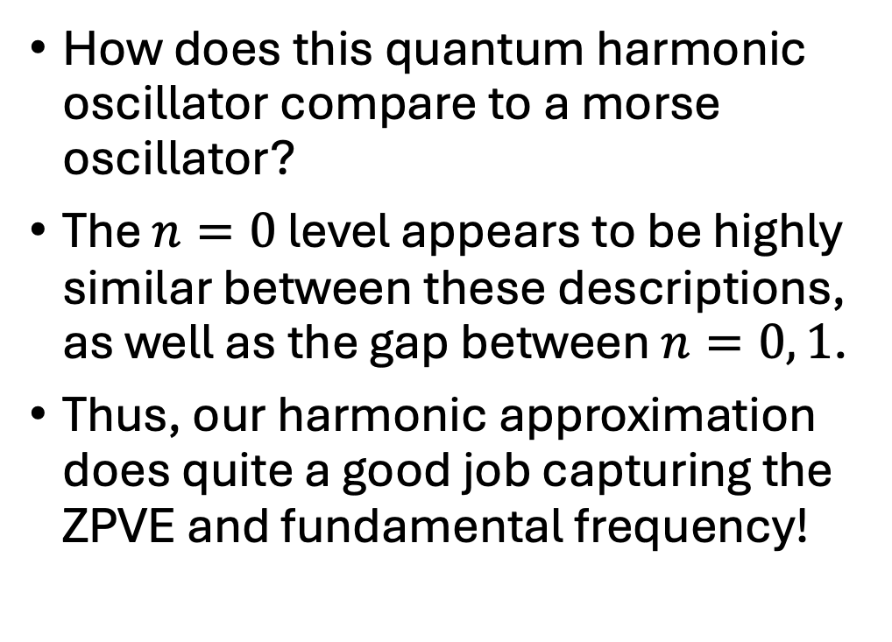
Quantum Harmonic Oscillator
How does this quantum harmonic oscillator compare to a morse oscillator?
The $n=0$ level appears to be highly similar between these descriptions, as well as the gap between $n=0, 1$.
Thus, our harmonic approximation does quite a good job capturing the ZPVE and fundamental frequency!
Credit to OpenOChem for this figure.

Slide 44
Quantum Anharmonicity
So then, what is anharmonicity?
Credit to OpenOChem for this figure.

Slide 45
Quantum Anharmonicity
So then, what is anharmonicity?
The harmonic approximation is so powerful and ubiquitous that all leftover effects required to describe a real oscillating molecule are simply called anharmonic effects.
Credit to OpenOChem for this figure.

Slide 46
Quantum Anharmonicity
So then, what is anharmonicity?
The harmonic approximation is so powerful and ubiquitous that all leftover effects required to describe a real oscillating molecule are simply called anharmonic effects.
A morse oscillator contains an anharmonic description of the oscillation of a diatomic molecule.
Credit to OpenOChem for this figure.

Slide 47
When do we need to worry about anharmonicity?
Comparing with experiment
All real molecules contain the full range of physical effects. (Duh)

Slide 48
When do we need to worry about anharmonicity?
Comparing with experiment
All real molecules contain the full range of physical effects. (Duh)
Systems that have a high degree of anharmonicity will require an anharmonic treatment if you want your frequencies to be useful for experimental comparison or prediction. e.g. C-H stretches.

Slide 49
When do we need to worry about anharmonicity?
Comparing with experiment
All real molecules contain the full range of physical effects. (Duh)
Systems that have a high degree of anharmonicity will require an anharmonic treatment if you want your frequencies to be useful for experimental comparison or prediction. e.g. C-H stretches.
Overtones will be more strongly influenced by anharmonicity

Slide 50
When do we need to worry about anharmonicity?
Comparing with experiment
All real molecules contain the full range of physical effects. (Duh)
Systems that have a high degree of anharmonicity will require an anharmonic treatment if you want your frequencies to be useful for experimental comparison or prediction. e.g. C-H stretches.
Overtones will be more strongly influenced by anharmonicity
Experimental kinetics may require an anharmonic ZPVE for extreme precision

Slide 51
When do we need to worry about anharmonicity?
Comparing with experiment
All real molecules contain the full range of physical effects. (Duh)
Systems that have a high degree of anharmonicity will require an anharmonic treatment if you want your frequencies to be useful for experimental comparison or prediction. e.g. C-H stretches.
Overtones will be more strongly influenced by anharmonicity
Experimental kinetics may require an anharmonic ZPVE for extreme precision
Experimentally derived molecular structures will be distorted by vibrational averaging

Slide 52
When do we need to worry about anharmonicity?
Comparing with experiment
All real molecules contain the full range of physical effects. (Duh)
Systems that have a high degree of anharmonicity will require an anharmonic treatment if you want your frequencies to be useful for experimental comparison or prediction. e.g. C-H stretches.
Overtones will be more strongly influenced by anharmonicity
Experimental kinetics may require an anharmonic ZPVE for extreme precision
Experimentally derived molecular structures will be distorted by vibrational averaging
Just getting the correct answer

Slide 53
How to compute harmonic and anharmonic frequencies
Harmonic frequencies are relatively simple.

Slide 54
How to compute harmonic and anharmonic frequencies
Harmonic frequencies are relatively simple.
Any major quantum chemistry code will have a built-in function to calculate harmonic frequencies.
Don’t let this fool you though, there are some factors to consider.

Slide 55
How to compute harmonic and anharmonic frequencies
Harmonic frequencies are relatively simple.
Any major quantum chemistry code will have a built-in function to calculate harmonic frequencies.
Don’t let this fool you though, there are some factors to consider.
In order to acquire the harmonic frequencies, you need to take the second-derivative of the potential energy surface.

Slide 56
How to compute harmonic and anharmonic frequencies
Harmonic frequencies are relatively simple.
Any major quantum chemistry code will have a built-in function to calculate harmonic frequencies.
Don’t let this fool you though, there are some factors to consider.
In order to acquire the harmonic frequencies, you need to take the second-derivative of the potential energy surface.
There are some highly accurate approximations that allow you to compute harmonic frequencies at a linear scaling rather than quadratic, such as the Concordant Mode Approach (CMA), developed by yours truly.

Slide 57
How to compute harmonic and anharmonic frequencies
Anharmonic computations are trickier.

Slide 58
How to compute harmonic and anharmonic frequencies
Anharmonic computations are trickier.
If you have a diatomic, you can simply compute the full PES and fit vibrational energy levels. Three or more atoms requires more advanced methods.

Slide 59
How to compute harmonic and anharmonic frequencies
Anharmonic computations are trickier.
If you have a diatomic, you can simply compute the full PES and fit vibrational energy levels. Three or more atoms requires more advanced methods.
Most common method is second-order vibrational perturbation theory (VPT2).
This method uses the third- and fourth-order derivatives we saw in the Taylor Series expansion.
CFOUR is commonly used in this group, PYVPT2 is an option. I will let Connor fill in any programs that I’ve missed.

Slide 60
How to compute harmonic and anharmonic frequencies
Anharmonic computations are trickier.
If you have a diatomic, you can simply compute the full PES and fit vibrational energy levels. Three or more atoms requires more advanced methods.
Most common method is second-order vibrational perturbation theory (VPT2).
This method uses the third- and fourth-order derivatives we saw in the Taylor Series expansion.
CFOUR is commonly used in this group, PYVPT2 is an option. I will let Connor fill in any programs that I’ve missed.
Vibrational configuration interaction (VCI) can be used when extreme accuracy is required, though it is extremely expensive to use.

Slide 61
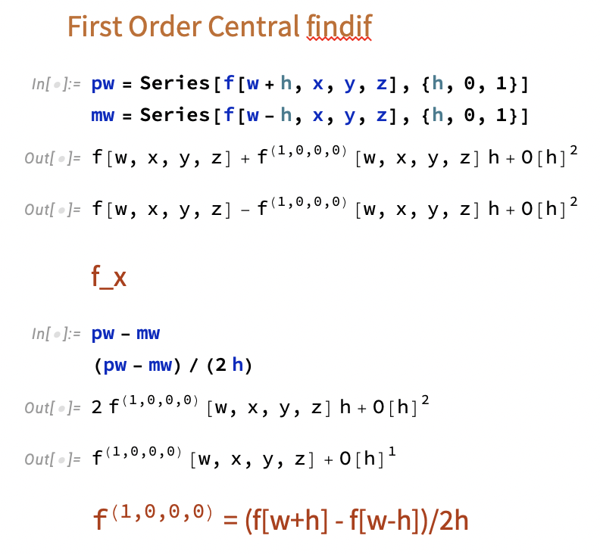
Bonus: How do we derive finite difference derivatives?

Slide 62
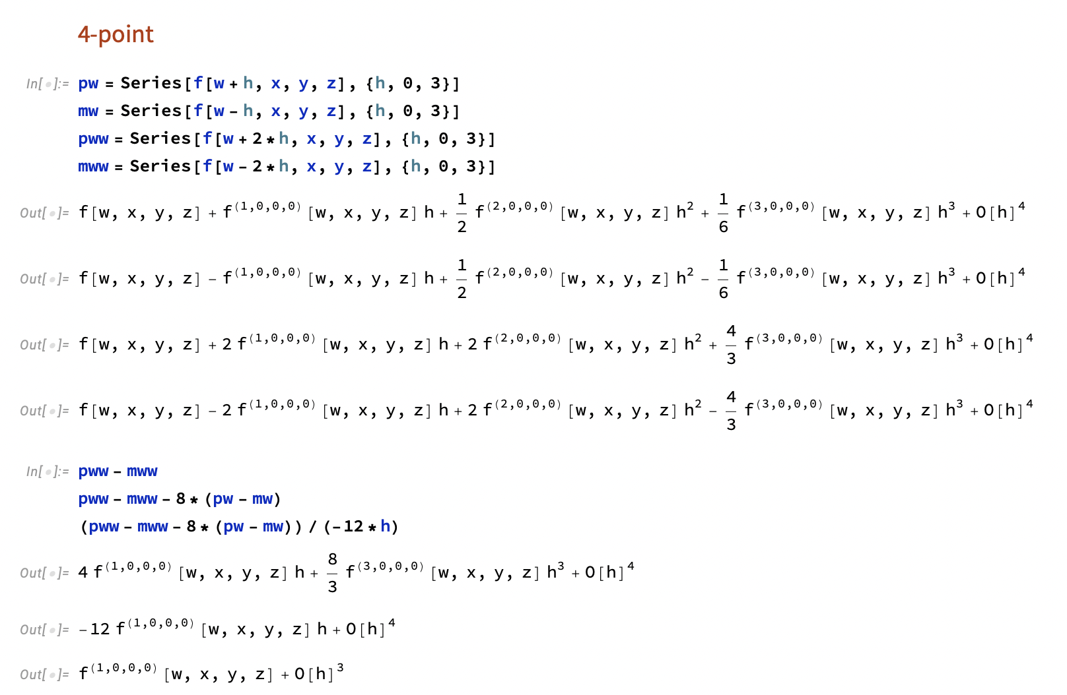
Bonus: How do we derive finite difference derivatives?

Slide 63
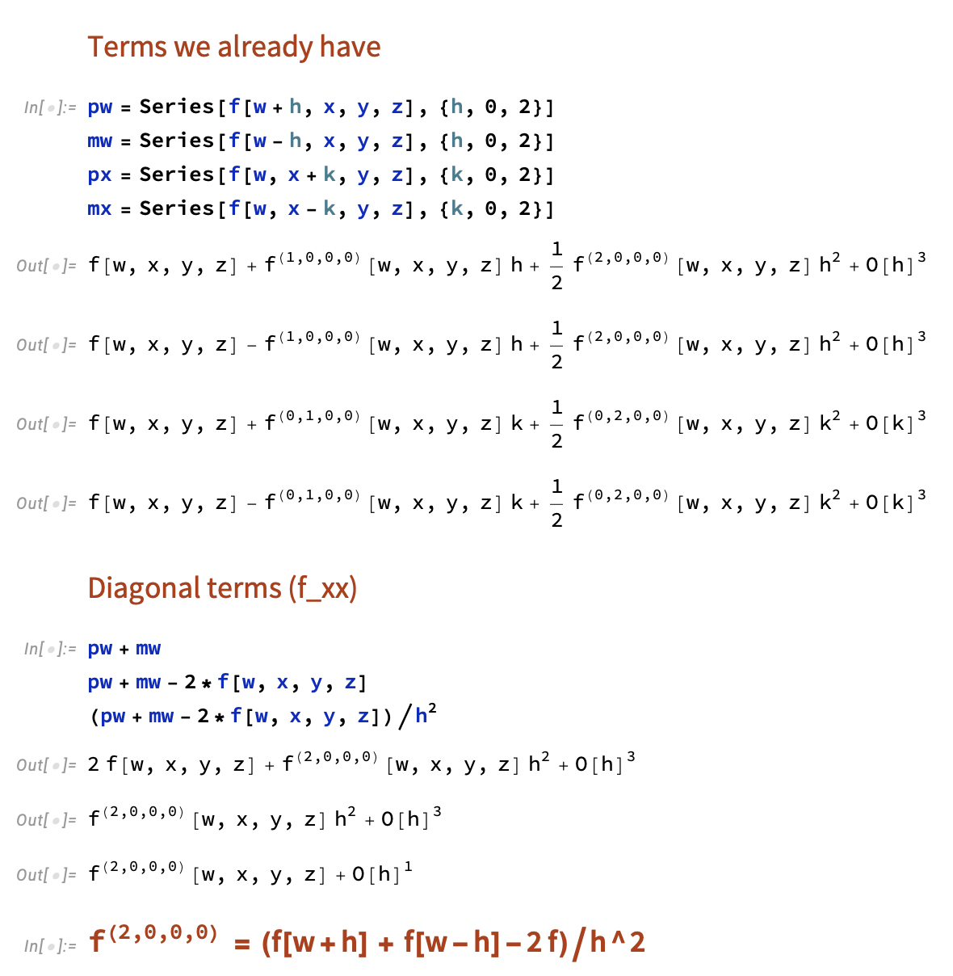
Bonus: How do we derive finite difference derivatives?

Slide 64
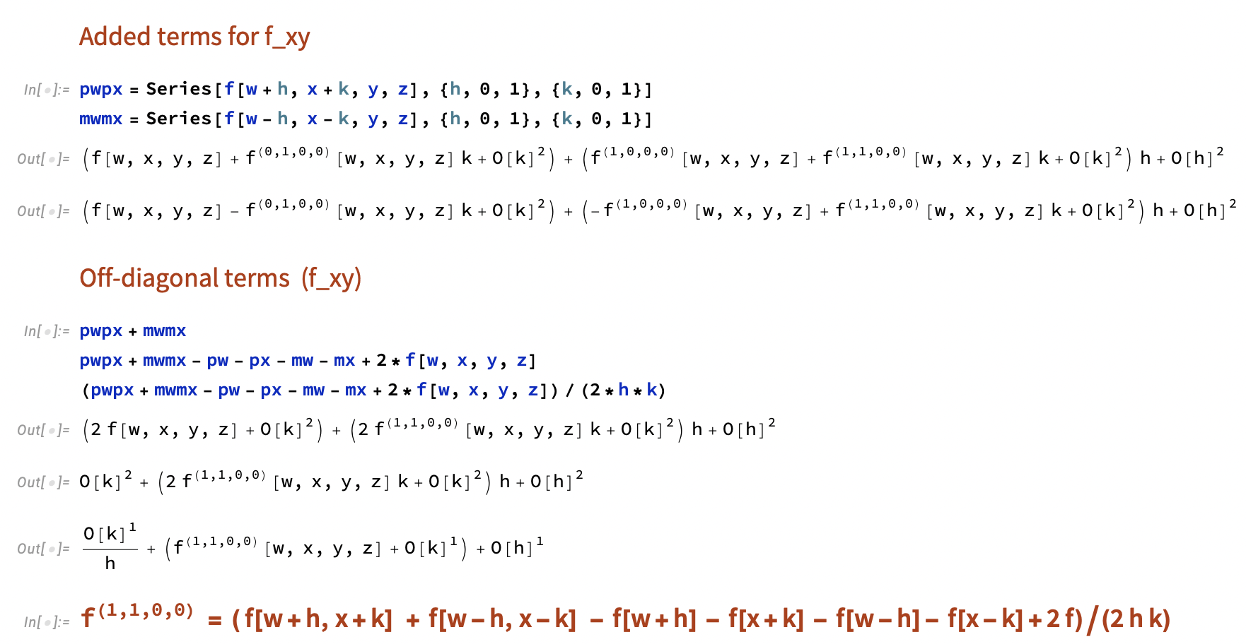
Bonus: How do we derive finite difference derivatives?

